Slide 1
Sessions 3 and 4

Slide 2
Protocol
Communication between two people or two devices needs to follow some protocol
A protocol is a set of rules that governs communication
For example, in a face-to-face communication between two persons, there is a set of implicit rules in each culture that define how two persons should start the communication, how to continue the communication, and how to end the communication

Slide 3
Network Software
Network software uses a protocol stack
A protocol stack contains many layers or levels
Each layer provides some services to the layer above it
Each layer hides complexity of its work from the layer above it
Creates a protocol hierarchy

Slide 4
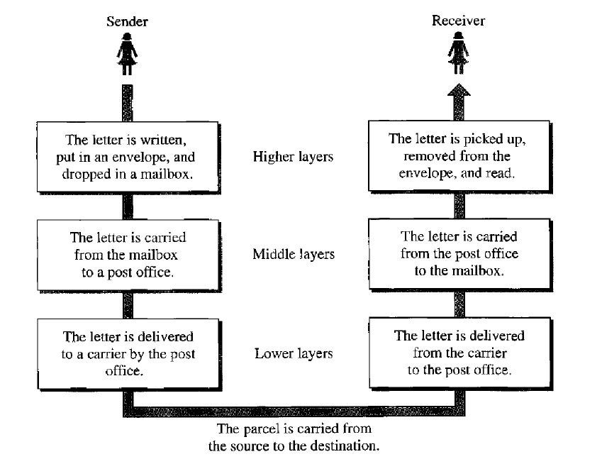
Protocol Hierarchy Example

Slide 5
OSI
Open Systems Interconnection
Good in theory, not used in practice
Contains 7 layers
Sometimes also called ISO/OSI

Slide 6
Layers in OSI
Application Layer
Presentation Layer
Session Layer
Transport Layer
Network Layer
Data Link Layer
Physical Layer
Notes:
6

Slide 7
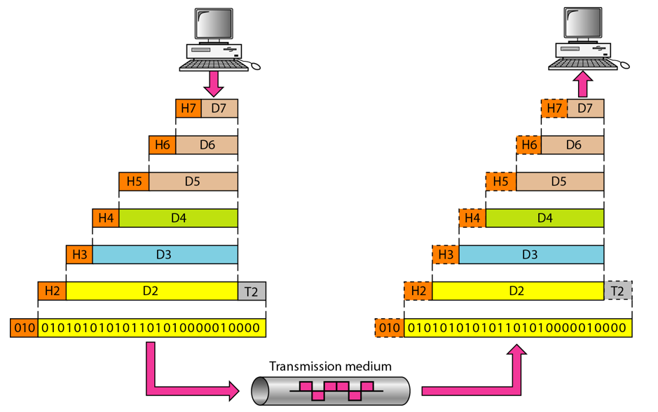
An Exchange using the OSI Model

Slide 8
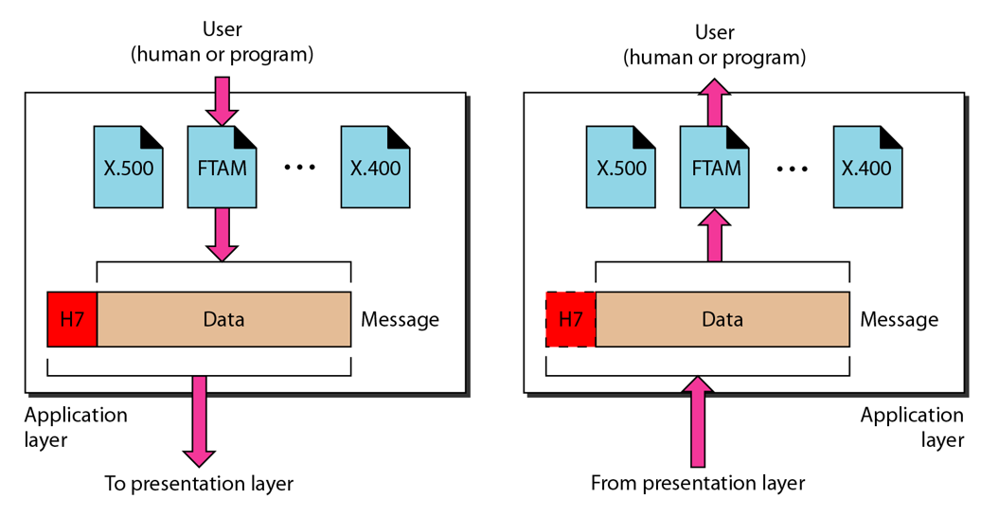
The Application Layer

Slide 9
Application Layer
Provides an “application view” to a network (e.g. email, file transmission)
Example: Hypertext Transfer Protocol (HTTP) is used to access Web pages
Encapsulation begins here
Other examples: Email (SMTP), File transfers (FTP), Querying domain names (DNS)

Slide 10
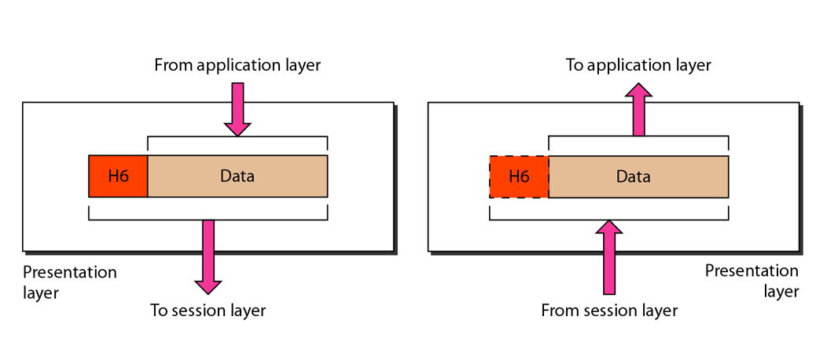
The Presentation Layer

Slide 11
Presentation Layer
Translation: Use of a common format to take care of differences (encoding, number representation etc)
Encryption: To achieve confidentiality or privacy
Compression: Reduces the number of bits needed to be transmitted

Slide 12
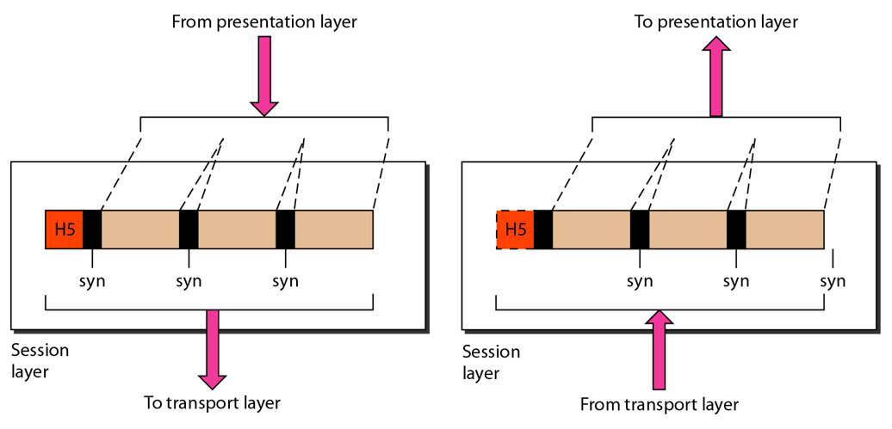
The Session Layer

Slide 13
Session Layer
Manages the session between applications
Example: Between browser of the source computer and server of the destination computer

Slide 14
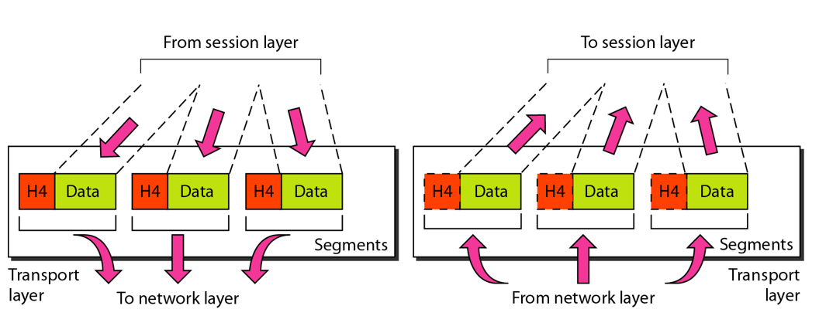
The Transport Layer

Slide 15
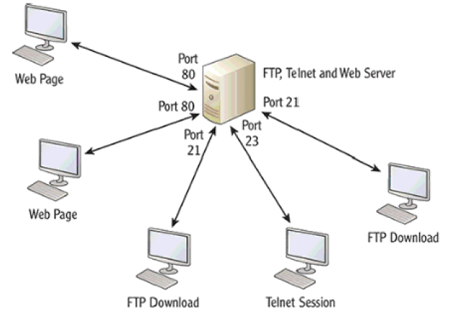
Transport Layer
Identifies the application on the destination computer using port numbers
Example: One server, multiple applications

Slide 16
Port Numbers
Port number is a 16-bit value, so it can store a number between 0 and 65,535
Port Number Range | Where used? | Called as
0-1023 | Server | Well-known ports
1024-49151 | Client | Temporary/Ephemeral
49152-65535 | NA | Dynamic, Usage-based

Slide 17
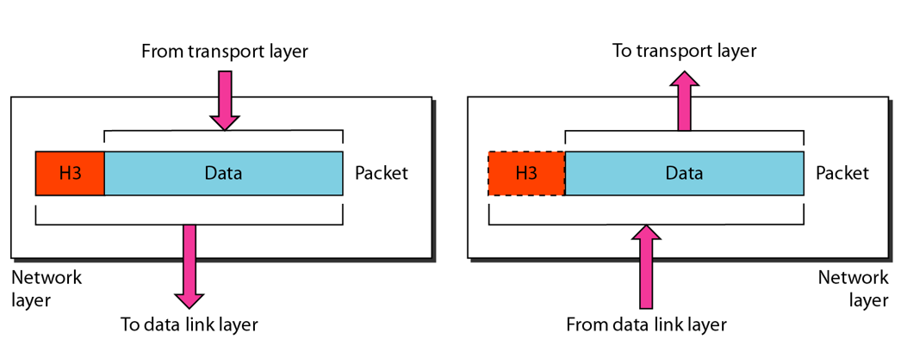
The Network Layer

Slide 18
Network Layer
Physical/MAC addresses are defined by data link layer to take care of addressing inside the same network
If a packet has to travel across a network to another network, physical addressing will not work
Hence, a universal address or a logical address is required. This is done at the network layer
This is the IP address

Slide 19
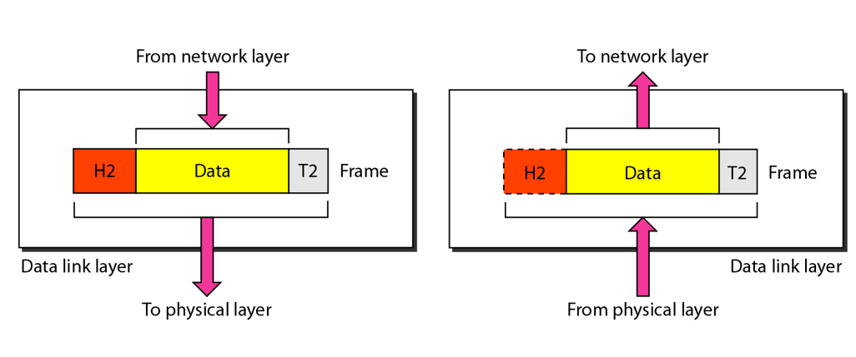
The Data Link Layer

Slide 20
Data Link Layer
Responsible for delivery of packets between two hosts connected to the same physical network (hop-to-hop – see next slide)
Cannot work across networks
Uses frames
Physical addressing: Adding sender’s and receiver’s physical addresses (also called MAC addresses) to the frame header
LAN/WAN operates at this layer (e.g. Ethernet or WiFi)
What if we know the IP address of a computer but do not know its MAC address?
Use Address Resolution Protocol (ARP)

Slide 21
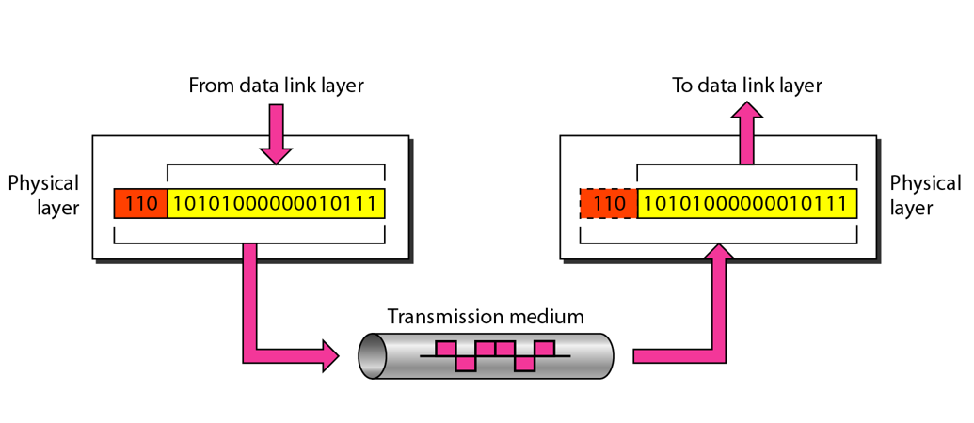
The Physical Layer

Slide 22
Physical Layer Functions
Carries the data (0s and 1s) in the form of signals
Signals can be electric, optical, or wireless

Slide 23
Physical and Logical Address
Each computer on the Internet has two addresses:
Physical address/MAC address/Hardware address
Fixed address, hardcoded on the Network Interface Card (NIC)
Different for different network type (e.g. Ethernet card, WiFi card)
Useful within or inside a network only
Logical address/IP address/Virtual address
Exists in software
Given by the network provider or your organization (usually temporary)
Useful outside a network (e.g. to reach another computer on the Internet, anywhere in the world)

Slide 24
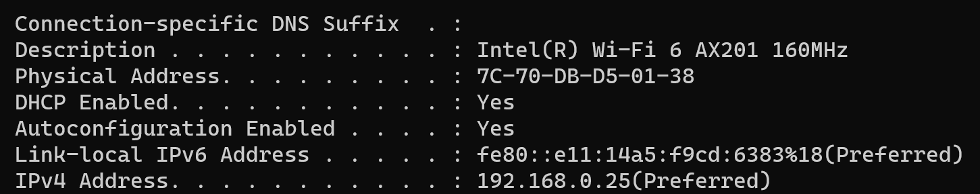
Example

Slide 25
Example
Suppose we have used our web browser to access a web page located on our company’s web server
Consider that the following are the details of the two computers
Computer | IP Address | MAC Address | Port Number
Web server | 192.168.5.1 | 5-5-5-5-5-5 | TCP 80
Laptop | 192.168.5.2 | 6-6-6-6-6-6 | TCP 5091

Slide 26
How will the Web Server Respond?
Layer 7 obtains the data in the form of the HTML document.
Layer 6 adds information about the formatting.
Layer 5 adds information required to create a session between the web server and the web browser on the laptop.
Layer 4 adds the transport protocol and the source and destination port numbers, in this case TCP (it's a unicast) and port 80 (HTTP).
Layer 3 adds the source and destination IP addresses, in this case a source of 192.168.5.1 and a destination of 192.168.5.2.
Layer 2 learns the destination MAC address and adds the source and destination MAC addresses, in this case, a source of 5-5-5-5-5-5 and destination of 6-6-6-6-6-6.
Layer 1 converts the entire package into bits and sends it across the network to the laptop.

Slide 27
How will the Laptop Handle this?
Layer 1 receives the bits in electrical format, converts them to be read by layer 2, and hands them to layer 2.
Layer 2 examines the destination MAC address to see whether it is addressed to it, sees the MAC address of 6-6-6-6-6 (its own), drops that part of the transmission, and hands the remaining data to layer 3.
Layer 3 examines the destination IP address to ensure that it is its own (192. 168.5.2), drops that part, and hands the rest of the package to layer 4.
Layer 4 examines the destination port number (port 5091), alerts the browser that HTTP data is coming in, drops that part, and hands the rest of the package to layer 5.
Layer 5 uses the information that was placed on this layer by the web server to create the session between the web server and the web browser and then hands the rest of the information to layer 6.
Layer 6 performs any format translation that may be required and hands the remaining data (the HTML document) to layer 7.
The layer 7 application (the web browser) receives the HTML document and opens the document in the browser window.

Slide 28
TCP/IP

Slide 29
Basics of TCP/IP
The TCP/IP protocol suite was developed prior to the OSI model
Therefore, the layers in the TCP/IP protocol suite do not match exactly with those in the OSI model
The original TCP/IP protocol suite was defined as four software layers built upon the hardware
Sometimes TCP/IP is thought of as a five-layer model with the layers named similarly to the ones in the OSI model

Slide 30
OSI versus TCP/IP
When we compare the two models, we find that two layers, session and presentation, are missing from the TCP/IP protocol suite
These two layers were not added to the TCP/IP protocol suite after the publication of the OSI model
The application layer in the suite is usually considered to be the combination of three layers in the OSI model
See diagram on the next slide

Slide 31
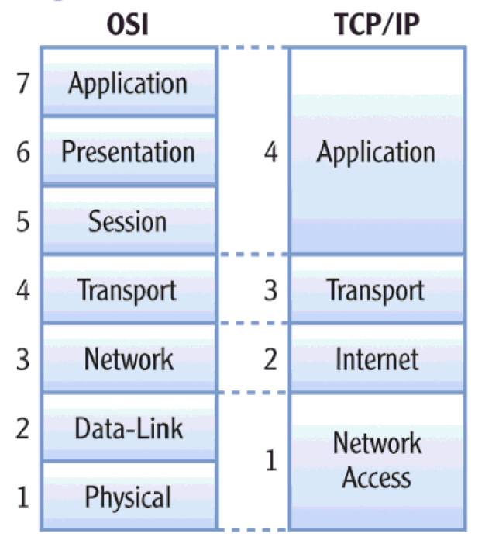
OSI versus TCP/IP

Slide 32
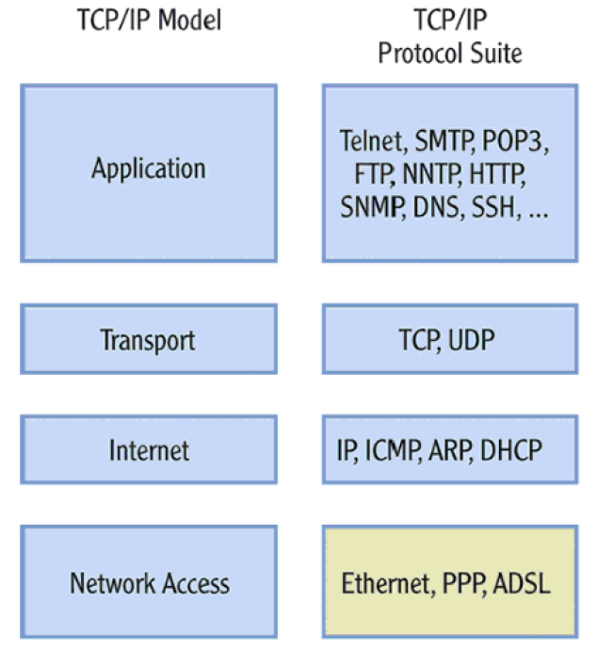
Protocols within Each TCP/IP Layer

Slide 33
Transport Layer Protocols
Transmission Control Protocol (TCP)
Reliable protocol
Guaranteed delivery
Uses connections, acknowledgements
Used for text-based data
User Datagram Protocol (UDP)
Unreliable protocol
No guarantee of delivery
No connections, no acknowledgements
Useful for audio, video or wherever we need speed but not guarantee

Slide 34
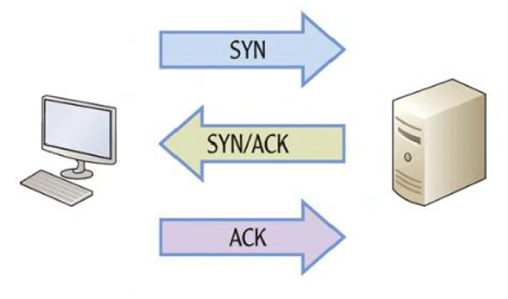
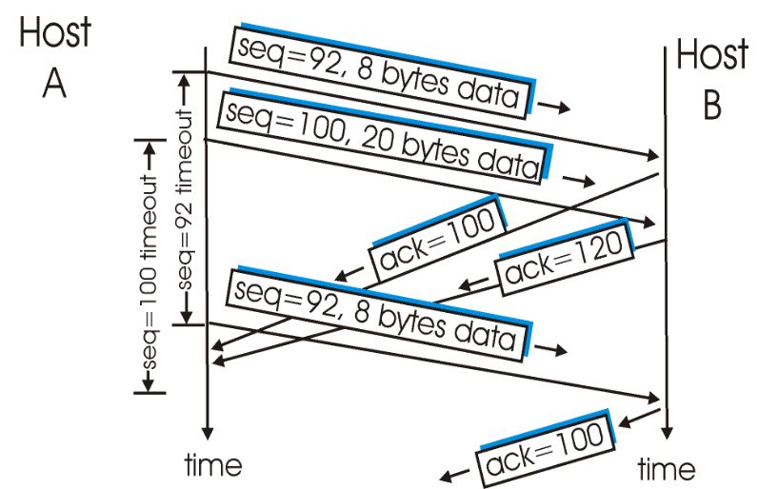
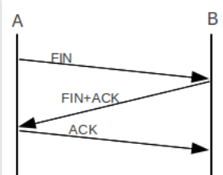
TCP – Connection Management
Connection establishment
Data transfer
Connection termination

Slide 35
UDP
No connection
No acknowledgement
No retransmissions in the case of errors

Slide 36
Internet Layer
Provides logical addressing (IP addresses)
Performs routing
Provides an IP datagram format (See next slide)

Slide 37
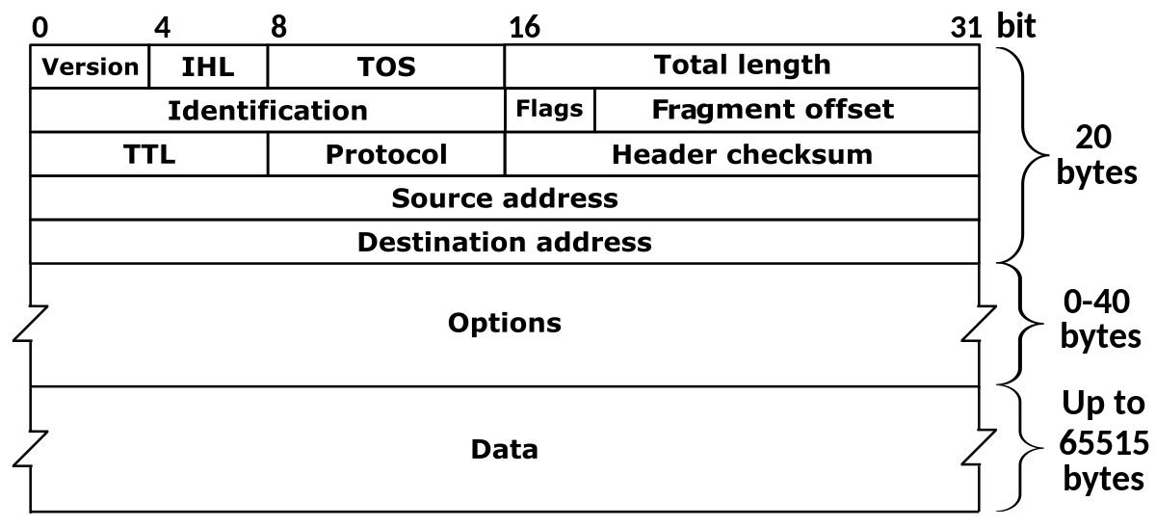
IP Datagram Format

Slide 38
Address Resolution Protocol (ARP)
Takes IP address of a computer as input and finds the MAC address of that computer
Useful to deliver the data to a particular MAC address

Slide 39
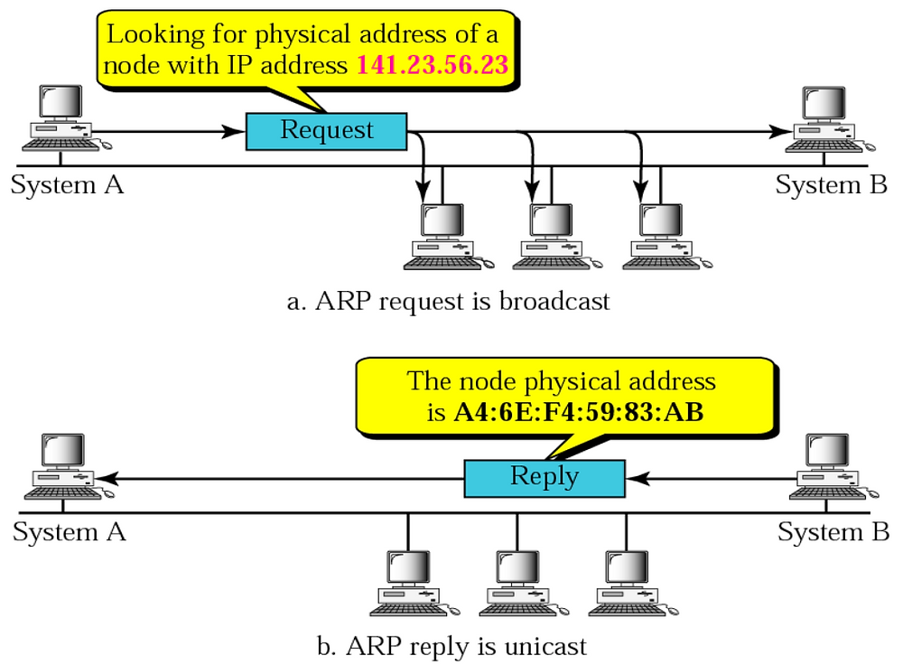
ARP Example

Slide 40
Internet Message Control Protocol (ICMP)
IP is
Connectionless
Unreliable
Unacknowledged
Datagrams are sent over the Internet with no prior connection, no assurance of delivery, and no acknowledgement if they reach the destination successfully
What happens if a router must discard a datagram because it cannot find a router to the final destination, or because the time-to-live field has a zero value?
What happens if the final destination host must discard all fragments of a datagram because it has not received all fragments within a predetermined time limit?
The Internet Control Message Protocol (ICMP) helps IP

Slide 41
ICMP Message Types
Error-reporting messages
Report problems that a router or a host (destination) may encounter when it processes an IP packet
Query messages
Occur in pairs, help a host or a network manager get specific information from a router or another host.
For example, nodes can discover their neighbors.
Also, hosts can discover and learn about routers on their network and routers can help a node redirect its messages.

Slide 42
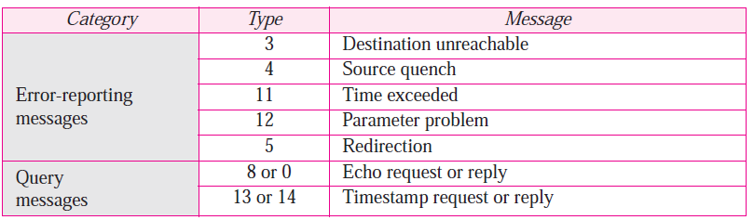
ICMP Messages
Notes:
42

Slide 43
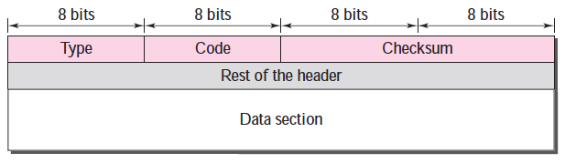
ICMP Message Format
Has a 8-byte header and variable-size data section
General format of the header is different for each message type, the first 4 bytes are common to all
Defines the type of the message
Specifies the reason for the specific message type
Carries information for finding the original packet that had error

Slide 44
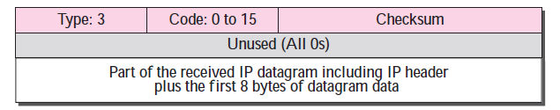
Example: Destination Unreachable
When a router cannot route an IP datagram, it sends this message
Notes:
44

Slide 45
Destination Unreachable – Sample ‘Code’ field Values
Code 0: Network is unreachable
Code 1: Host is unreachable
Code 2: Protocol is unreachable (e.g. TCP is not running on the destination)
Code 3: Port is not reachable
Code 4: Fragmentation is needed, but “Do not fragment” field is set
Code 6: Destination network is unknown
Code 7: Destination host does not exist
Notes:
45

Slide 46
Sessions 6 and 7: IP Addressing and Routing

Slide 47
IP Address
An IP address has two parts:
Network Id: Identifies which network it belongs to
Host Id: On a given network, what is the host number
Examples:
This notation is called as dotted decimal notation
Some portion of the network id is reserved to indicate class of IP address
Hence, this is called as classful addressing
14.22.130.89
143.1.99.204
193.56. 78.21

Slide 48
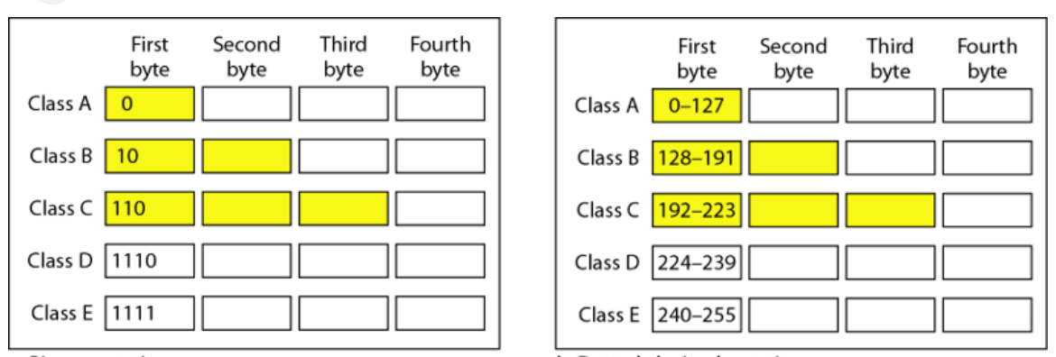
Classful Addressing

Slide 49
Classes – How to Determine/Remember? – Three Techniques
Look at the first few bits of the binary value of the network id
First bit 0: Class A
First two bits 10: class B
First three bits 110: class C
Look at the first decimal octet/byte value of the network id
0-127: Class A
128-191: Class B
192-223: Class C
Use the flow-chart on the following slide

Slide 50
Determining Class
First bit = 0?
Yes
Class A address
No
Second bit = 0?
Yes
Class B address
No
Third bit = 0?
Yes
Class C address
No
Fourth bit = 0?
Yes
Class D address
No
Class E address
Notes:
50

Slide 51
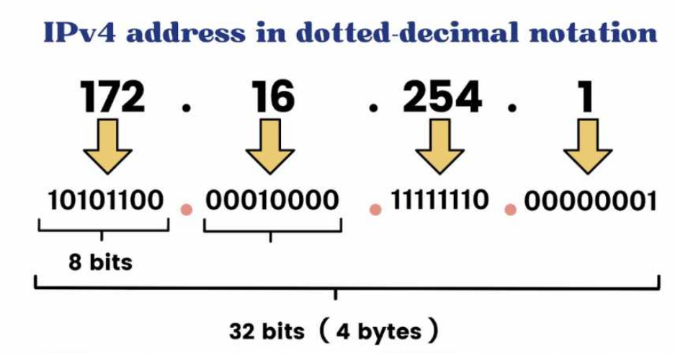
Dotted Decimal Notation

Slide 52
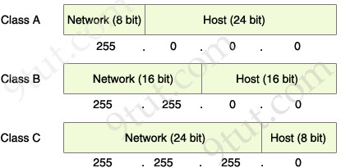
Another View

Slide 53
IP Addresses Allocation to Classes
Notes:
53

Slide 54
Exercise
How many addresses can each of the classes have?
Notes:
54

Slide 55
Addresses Per Class
Class | Number of Addresses | Percentage
A | 20 Lakh | 50%
B | 10 Lakh | 25%
C | 5 Lakh | 12.5%
D | 2.5 Lakh | 6.25%
E | 2.5 Lakh | 6.25%
Notes:
55

Slide 56
Exercise
Find the class of the following addresses
227.12.14.87
193.14.56.22
14.23.120.8
252.5.15.111
134.11.78.56
Notes:
56

Slide 57
Determining Class Based on an IP Address
Class | Contents of First Byte (Last three are not shown)
A | 1 to 126 (0 and 127 are reserved)
B | 128 to 191
C | 192 to 223
D | 224 to 239
E | 240 to 255
Notes:
57

Slide 58
Subnetting
Notes:
58

Slide 59
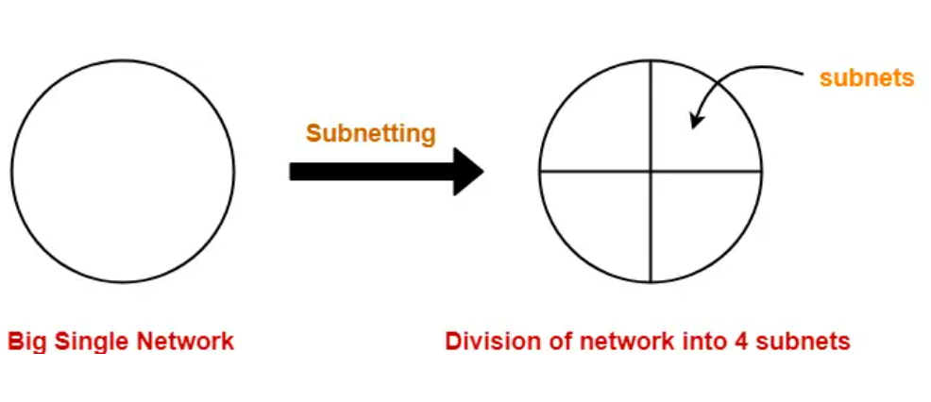
Subnetting Concept

Slide 60
Subnet Concept
Network id
Host id
Two ways to address a particular house
Building number, House number (Normal IP address)
Building number, Floor number, House number (IP address with subnet)
Subnet id
Network id
Host id
Notes:
60

Slide 61
Subnetting
Divide a network into smaller sub-networks with each subnet having its own IP address
Allow a network to be split into several internal sub-networks, but act like a single network to the outside world
Motivation: Make better use of the IP address space
IP addresses: Two levels of hierarchy; subnetting makes it three
Notes:
61

Slide 62
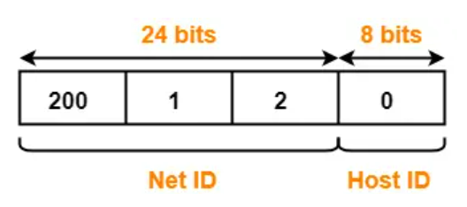
Subnetting Example
Consider a network having IP address 200.1.2.0
We want to divide this into two parts, creating two subnets
Analysis: Network belongs to class C

Slide 63
Subnetting Example
We want to create two subnets
Subnet 1 will have id 0₂
Subnet 2 will have id 1₂
IP address length is always 32 bits
For the current example, we have:
Net id: 24 bits
Host id: 8 bits
We need one bit for the subnet id: From where to take, and why?

Slide 64
Subnetting Example
If we take 1 bit from the net ID
Net id will become 23 bit
What will be the impact?
Current net ID is:
Which bit to take?
Suppose we take the last bit in the third octet (i.e. 0)
Now net ID will become 200.1.1 (because last octet will now be of only 7 bits 0000001)
Suppose we take the first bit in the first octet (i.e. 1)
Now net ID will become 72.1.1 (because first octet will now be of only 7 bits 1001000)
Conclusion: We cannot touch the net ID
200 | 1 | 2
11001000 | 00000001 | 00000010

Slide 65
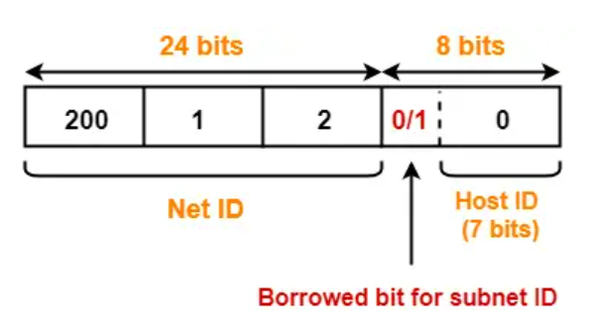
Subnetting Example
Conclusion: We must take one bit from the host id
This bit must be from the leftmost part of the host id
Now, the host id will only have 7 bits
If borrowed bit = 0, then it represents the first subnet
If borrowed bit = 1, then it represents the second subnet

Slide 66
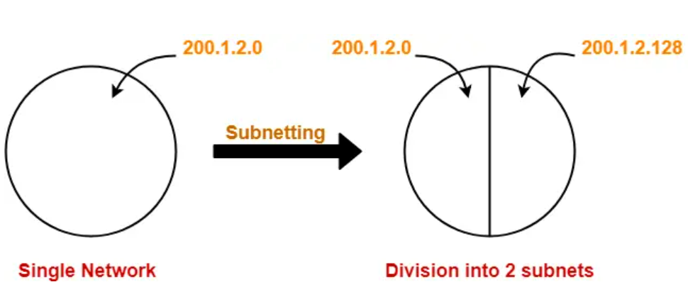
Resulting Subnets
IP addresses of the two subnets:
200.1.2.00000000 = 200.1.2.0
200.1.2.10000000 = 200.1.2.128

Slide 67
Subnet 1
Network address of the subnet = 200.1.2.0
Total number of IP Addresses = 2⁷ = 128
Total number of hosts that can be configured = 128 – 2 = 126
Range of IP Addresses = [200.1.2.00000000, 200.1.2.01111111] = [200.1.2.0, 200.1.2.127]
Broadcast Address = 200.1.2.01111111 = 200.1.2.127

Slide 68
Subnet 2
Network address of the subnet = 200.1.2.128
Total number of IP Addresses = 2⁷ = 128
Total number of hosts that can be configured = 128 – 2 = 126
Range of IP Addresses = [200.1.2.10000000, 200.1.2.11111111] = [200.1.2.128, 200.1.2.255]
Direct Broadcast Address = 200.1.2.11111111 = 200.1.2.255

Slide 69
Exercise
Consider that we have a single network having IP Address 200.1.2.0
We want to do subnetting and divide this network into 4 subnets

Slide 70
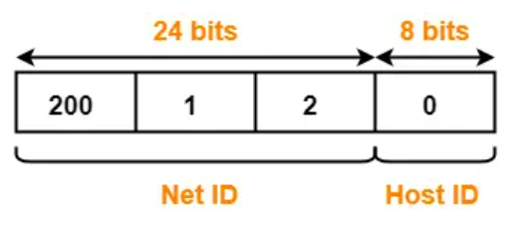
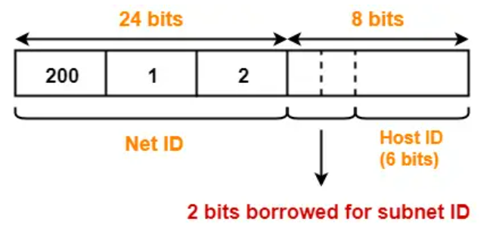
Solution
The network belongs to class C
To create 4 subnets, we need 2 bits from the host id to be used as subnet id
Host id will now have 6 bits
Subnet IDs
Subnet ID 1: 00
Subnet ID 2: 01
Subnet ID 3: 10
Subnet ID 4: 11

Slide 71
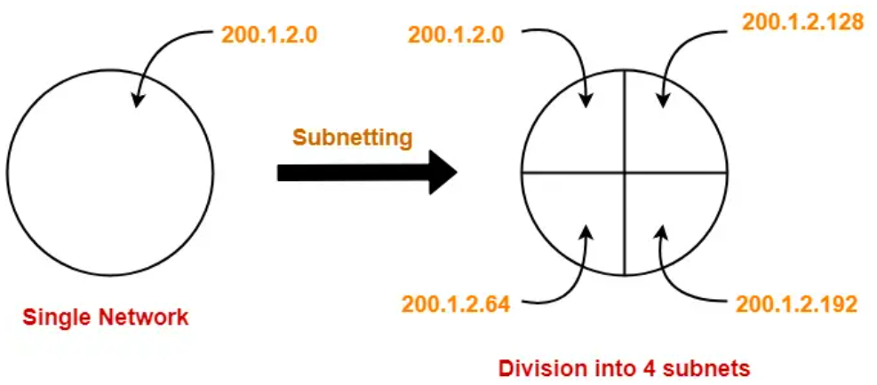
Solution
IP addresses of the four subnets
200.1.2.00000000 = 200.1.2.0
200.1.2.01000000 = 200.1.2.64
200.1.2.10000000 = 200.1.2.128
200.1.2.11000000 = 200.1.2.192

Slide 72
Subnet 1
Network Address of the subnet = 200.1.2.0
Total number of IP Addresses = 2⁶ = 64
Total number of hosts that can be configured = 64 – 2 = 62
Range of IP Addresses = [200.1.2.00000000, 200.1.2.00111111] = [200.1.2.0, 200.1.2.63]
Broadcast Address = 200.1.2.00111111 = 200.1.2.63

Slide 73
Subnet 2
Network Address of the subnet = 200.1.2.64
Total number of IP Addresses = 2⁶ = 64
Total number of hosts that can be configured = 64 – 2 = 62
Range of IP Addresses = [200.1.2.01000000, 200.1.2.01111111] = [200.1.2.64, 200.1.2.127]
Broadcast Address = 200.1.2.01111111 = 200.1.2.127

Slide 74
Subnet 3
Network Address of the subnet = 200.1.2.128
Total number of IP Addresses = 2⁶ = 64
Total number of hosts that can be configured = 64 – 2 = 62
Range of IP Addresses = [200.1.2.10000000, 200.1.2.10111111] = [200.1.2.128, 200.1.2.191]
Broadcast Address = 200.1.2.10111111 = 200.1.2.191

Slide 75
Subnet 4
Network Address of the subnet = 200.1.2.192
Total number of IP Addresses = 2⁶ = 64
Total number of hosts that can be configured = 64 – 2 = 62
Range of IP Addresses = [200.1.2.11000000, 200.1.2.11111111] = [200.1.2.192, 200.1.2.255]
Broadcast Address = 200.1.2.11111111 = 200.1.2.255

